Slide 1

H4529 Processing or Direct Delivery Transfers
OCTOBER 2026

Slide 2
Processing or Direct Delivery Transfers
Transfers for Processing and Direct Delivery are managed the same.
Direct Delivery has a very limited amount of excess inventory.
The transfer form does not conduct Surplus transfers.
Additional inventory at the Warehouses is moved to the Surplus account.
Warehouses advertise available additional inventory through emails and their proprietary systems known as Surplus.
TEXAS DEPARTMENT OF AGRICULTURE FOOD AND NUTRITION – USDA FOODS
2

Slide 3
Criteria for Processing and Direct Delivery Transfer Requests
Account should not have more than 1-1.5 Months on Hand when requesting additional inventory
Acceptable usage – reflects using 10% of total inventory each month.
Approved amount is based upon the Average Monthly Usage for 3 months.
TEXAS DEPARTMENT OF AGRICULTURE FOOD AND NUTRITION – USDA FOODS
3

Slide 4
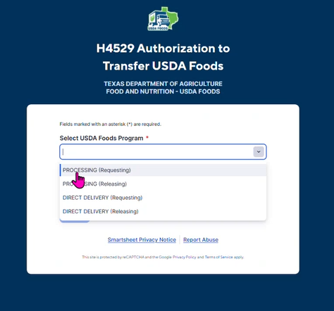
TO BEGIN
Select your USDA Foods Program:
Processing (Requesting)
Processing (Releasing)
Direct Delivery (Requesting)
Direct Delivery (Releasing)
Requesting = Requesting Additional inventory & Releasing = Sending inventory Back to State Accounts

Slide 5
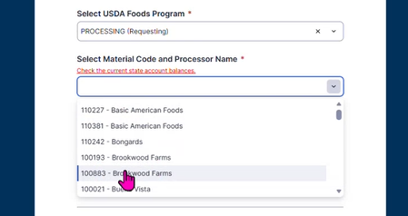

Processing (Requesting)
STEP 3
Select your Processor and Material Code
STEP 4
Select the number of pounds requested.

Slide 6
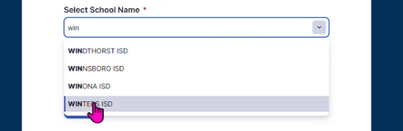


Processing (Requesting)
STEP 5
Select your School District.
Enter the first three letters of the district to manage the search.
STEP 6
Send a copy to yourself by checking the box: “Send me a copy of my responses” and entering an email.
STEP 7
Select SUBMIT. An automated copy of the request will be emailed to school districts.

Slide 7
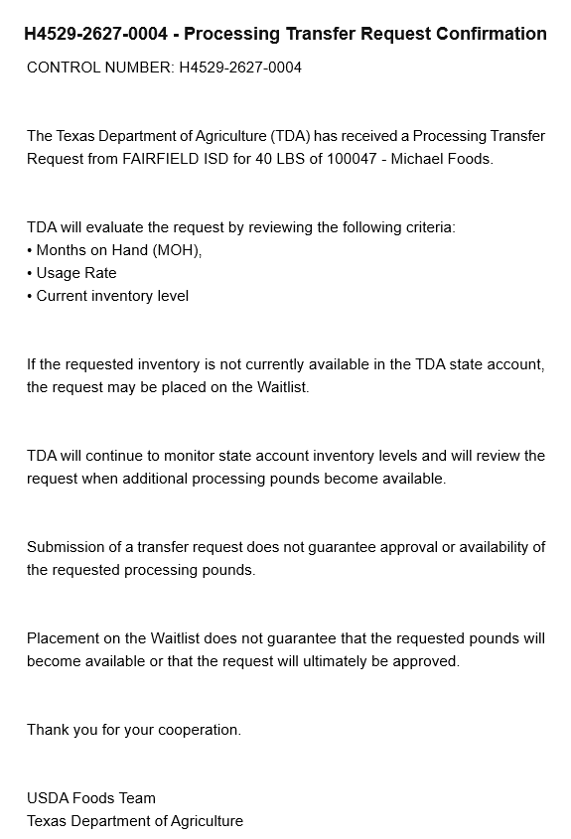
After the transfer request has been submitted a confirmation email will be delivered to your inbox from Texas Department of Agriculture via SmartSheet.
The email has a Control Number at the top starting with H4529 to easily reference the submission with TDA or Processors.
TEXAS DEPARTMENT OF AGRICULTURE FOOD AND NUTRITION – USDA FOODS
7

Slide 8
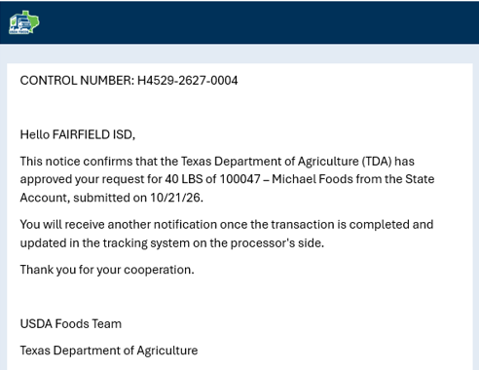
Transfer Approved
An email will confirm TDA approved the transfer and on stand-by until the processor conducts the transfer.
Another email will follow when the transaction is posted and complete.
TEXAS DEPARTMENT OF AGRICULTURE FOOD AND NUTRITION – USDA FOODS
8

Slide 9
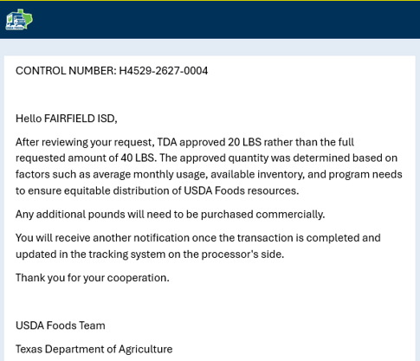
Transfer Approved w/Adjusted Amount
An email will confirm what the final transfer amount being transferred is.
Transferred amount depends on the Average Monthly Usage (AMU) up to 3 months.
TEXAS DEPARTMENT OF AGRICULTURE FOOD AND NUTRITION – USDA FOODS
9

Slide 10
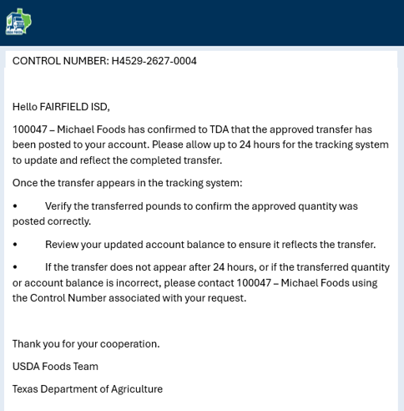
Transfer Has Posted
Processors will notify TDA when transfer is posted.
TDA will notify School Districts of the transfer completion.
The tracking systems post within 24 hours.
Validate the transfer amount is in your tracking system account.
TEXAS DEPARTMENT OF AGRICULTURE FOOD AND NUTRITION – USDA FOODS
10

Slide 11
H4529 Waitlist
OCTOBER 2026

Slide 12
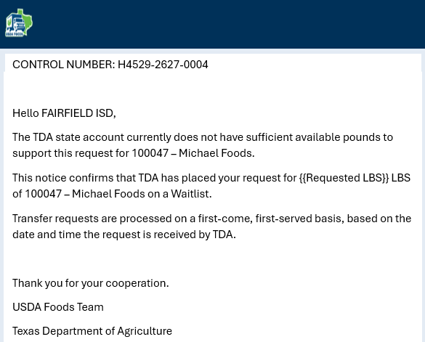
State Account Depleted
If State Account(s) have no inventory, eligible requests are automatically placed on a Waitlist.
40 LBS
Order of fulfilling is first-come, first-served according to submission.
TEXAS DEPARTMENT OF AGRICULTURE FOOD AND NUTRITION – USDA FOODS
12

Slide 13
H4529 Transfer Not Approved
OCTOBER 2026

Slide 14
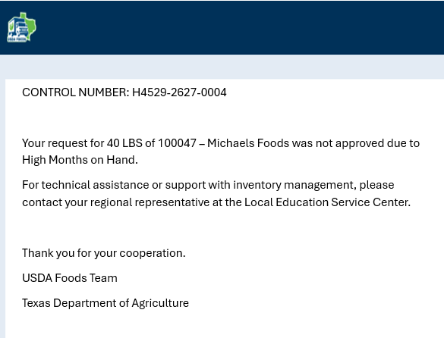
Transfer Not Approved
If account does not meet criteria, a notification stating the reason why is listed.
ESC is your primary contact and provides technical assistance and support.
TEXAS DEPARTMENT OF AGRICULTURE FOOD AND NUTRITION – USDA FOODS
14

Slide 15
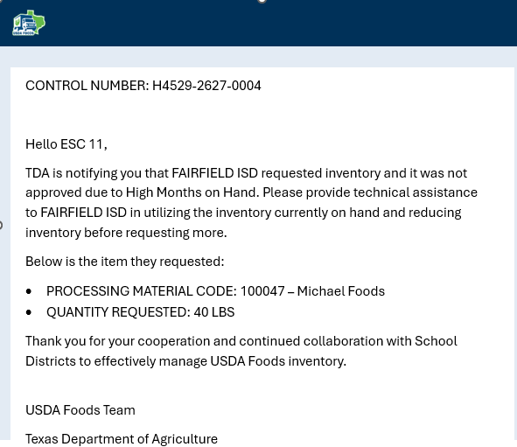
Transfer Not Approved – ESC Contacted
If request is not approved, TDA notifies the Regional ESC staff to assist.
ESCs assist in menu planning, forecasting and usage plans to drawdown the inventory to an acceptable rate.
TEXAS DEPARTMENT OF AGRICULTURE FOOD AND NUTRITION – USDA FOODS
15

Slide 16
H4529 Releasing to Processor or Warehouse
OCTOBER 2026

Slide 17
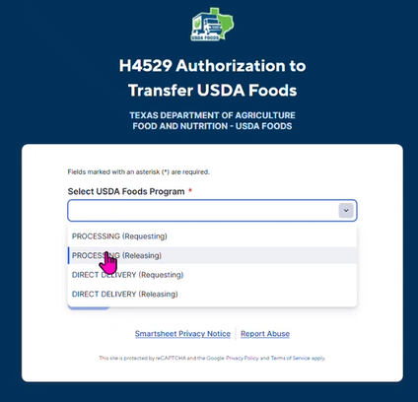
Processing (Releasing)
STEP 1
Selecting Releasing sends the inventory back to the State Account.
An automatic notification will be sent to your Education Service Center Representative for technical assistance.
The ESC will contact you to discuss options to utilize these pounds.

Slide 18
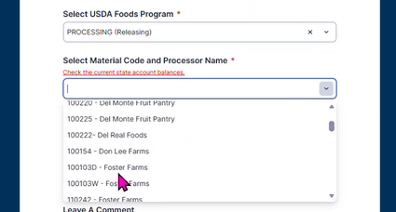
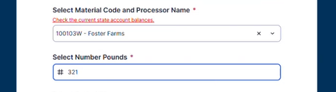
Processing (Releasing)
STEP 2
Select the Processor and Material Code.
STEP 3
Enter the number of pounds willingly released to the State Account.

Slide 19

Processing (Releasing)
STEP 4
Select your School District.
Enter the first three letters of the district to manage the search.
STEP 5
Send a copy to yourself by checking the box.
STEP 6
Leave a comment explaining why the pounds are being released.
STEP 7
Submit.

Slide 20
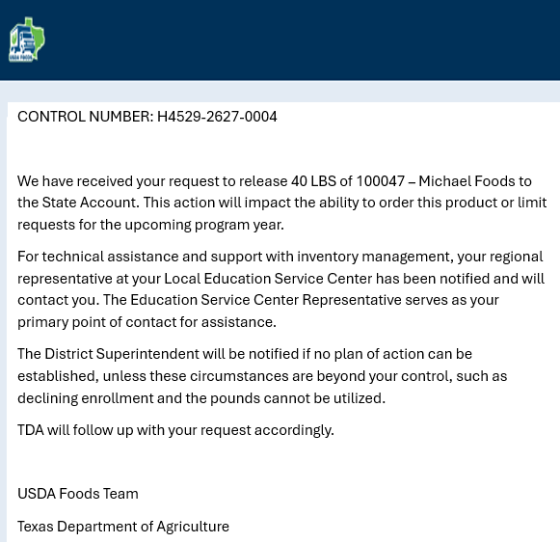
Releasing Inventory to State Account or Warehouse
Impacts future ordering of that product by limiting the amount or being able to order.
ESCs work with School Districts to create a Usage Plan and if one is not established, this requests escalates to notifying the Superintendent.
TEXAS DEPARTMENT OF AGRICULTURE FOOD AND NUTRITION – USDA FOODS
20

Slide 21
H4529 District Superintendent Notification
OCTOBER 2026

Slide 22
Releasing Processing or Direct Delivery Inventory
TDA will contact ESCs to work with School District on a plan to drawdown.
A comment is expected of why release to state and not utilizing.
District Superintendent will be notified of the donated food value.
Forfeiting Entitlement will impact ordering abilities for next program year.
TEXAS DEPARTMENT OF AGRICULTURE FOOD AND NUTRITION – USDA FOODS
22

Slide 23
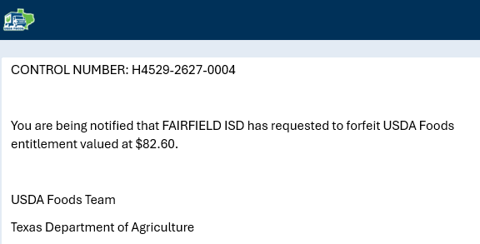
Superintendent Notified of Forfeiture of Entitlement
If no Usage Plan is established with ESC, the Superintendent will be notified.
TDA will conduct the transfer that will impact ordering this product for the upcoming program year.
TEXAS DEPARTMENT OF AGRICULTURE FOOD AND NUTRITION – USDA FOODS
23

Slide 24
This concludes the training of H4529 Transfers
OCTOBER 2026

